Slide 1
Detection Of Lung Cancer Using Radiology Images (CNN)
: Developed By:
Sheetal P
Meghana H D
Vidyashree M B
Smruthi S Kiran

Slide 2
TABLE OF CONTENTS
Introduction
Purpose
Block Diagram
Flow Chart
Software Designing
Result
Advantages and Disadvantages
Conclusion

Slide 3
INTRODUCTION
Deep learning is a class of machine learning algorithms that uses multiple layers to progressively extract highest level features from the raw input.
Deep Learning is a subfield of machine learning concerned with algorithms inspired by the structure and function of the brain called artificial neural networks.
According to Huang et al, Deep Learning has gained large popularity within different fields of interest ranging from a theoretical research in academia to practical application in industry.
Deep Learning Neural Networks works well for my lung cancer detection project as our dataset is large and can iteratively grow larger as more people infer new data to it which will result in a boost in performance.

Slide 4
PURPOSE
Tumors are continuously evolving biological systems, and medical imaging is uniquely positioned to monitor changes throughout treatment. Smoking causes the majority of lung cancers both in smokers and in people exposed to second hand smoke. But lung cancer also occurs in people who never smoked and in those who never had prolonged exposure to second hand smoke. In these cases, there may be no clear cause of lung cancer Early prediction of Lung cancer will help with the survival of cancer patients. Machine learning and Deep Learning have been widely used in the diagnosis of Lung cancer and on the early detection. The main aim of this research is to review the role of deep learning techniques in Lung cancer detection and diagnosis.

Slide 5
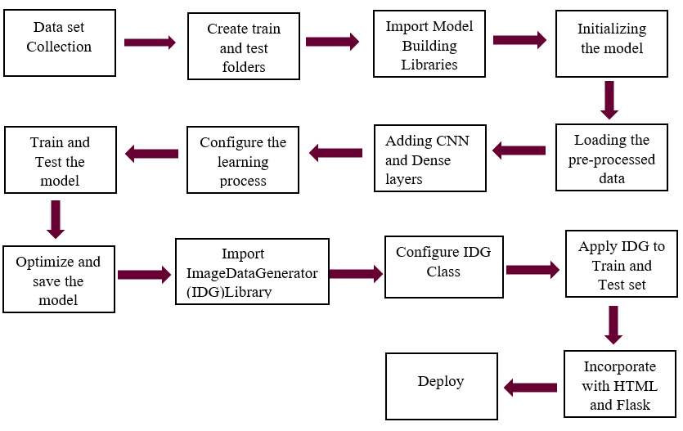
Block Diagram

Slide 6
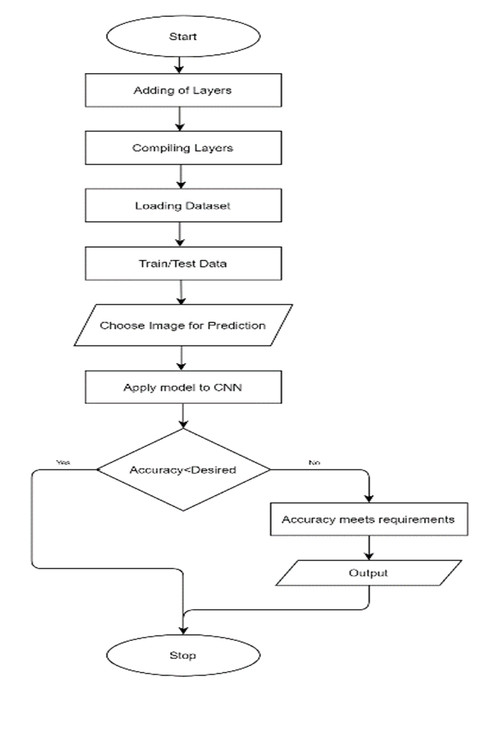
FlowChart

Slide 7
Software Designing
● Jupyter Notebook Environment
● Spyder Ide
● Machine Learning Algorithms
● Python (pandas, numpy, matplotlib, seaborn, sklearn)
● HTML
● Flask
We developed this lung cancer prediction by using the Python language which is a interpreted and high level programming language and using the Deep Learning algorithms.
For coding we used the Jupyter Notebook environment of the Anaconda distributions and the Spyder, it is an integrated scientific programming in the python language.
For creating an user interface for the prediction we used the Flask. It is a micro web framework written in Python.
A scripting language to create a webpage is HTML by creating the templates to use in th functions of the Flask and HTML.

Slide 8
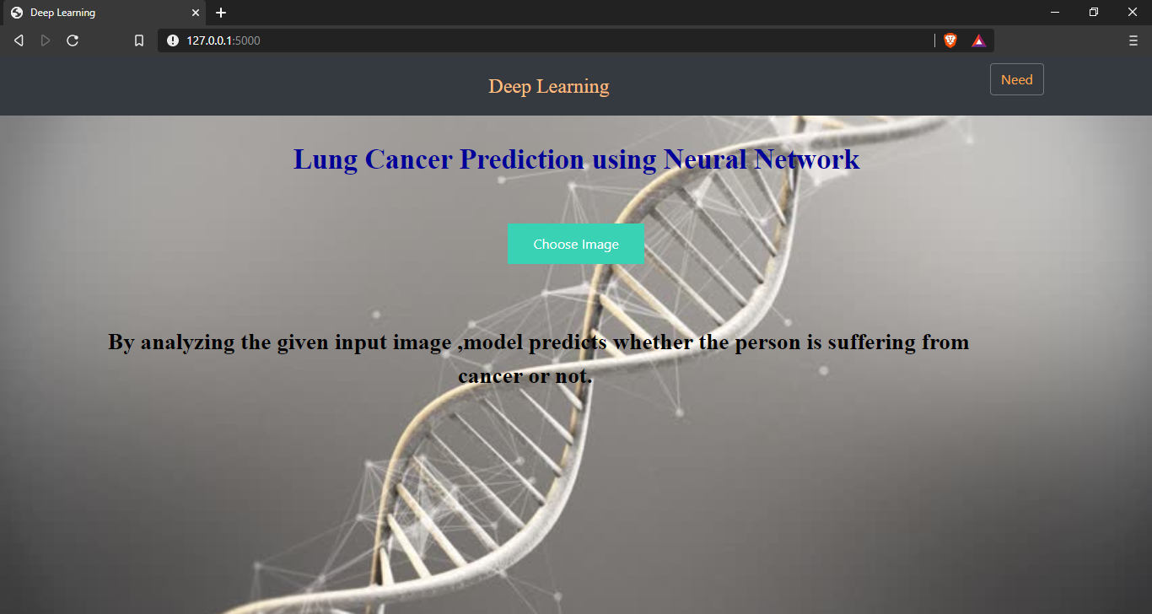
RESULT
Fig1: Home Screen

Slide 9
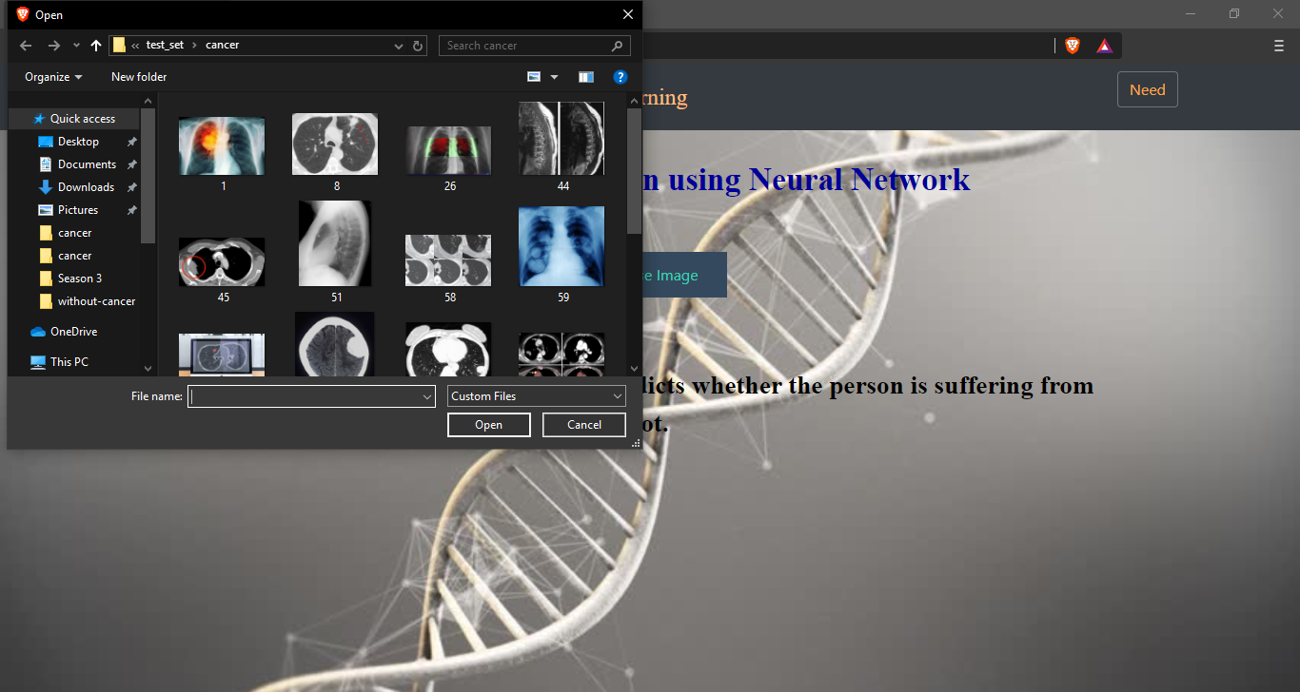
Fig2: Selection of Image

Slide 10
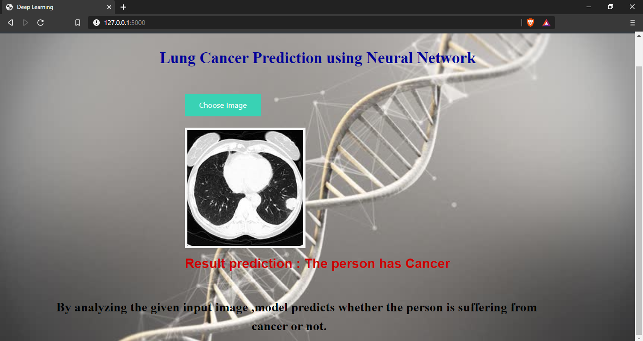
Fig3: Final Prediction

Slide 11
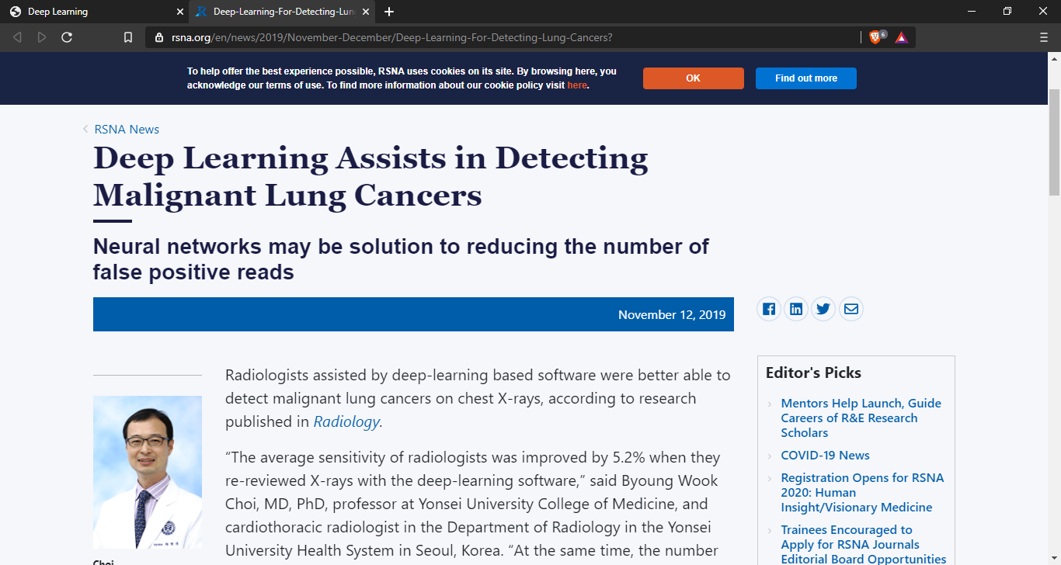
Fig4: Redirected when clicked on Need button

Slide 12
Advantages and Disadvantages
ADVANTAGES
Easy and simple User Interface for detection of lung cance at early stage using radiology images
The known benefits of lung cancer screening include reduced lung cancer mortality and using it as a “teachable moment for smoking cessation, which is the single best way to prevent lung cancer,”
It is composed using the HTML and Python for the web usage in real time.
DISADVANTAGES
There are also potential harms to doing these studies that are usually related to patients who are low risk or who will not benefit from screening results in unnecessary diagnostic tests, potentially unnecessary invasive procedures.
It could not work anywhere like an web-application, if one is using other should be quiet.
Needs more than a single value for the prediction.
Advantages and Disadvantages

Slide 13
CONCLUSION
An image processing technique is built to detect diseases at early stage of cancer so the patient can take the treatment at early stages.The time factor is major factor to discover the abnormal tissue in target x-ray images.The accuracy and the quality of image is one the major core factor of this research. The empirical results demonstrate the advantage of the proposed CNN system for detecting lung cancer.The main feature for detection of accurate image comparison are pixel percentage and mask labeling which gives us the indication that the process of detection this disease plays a very important and essential role to avoid serious stages and to reduce its percentage distribution in the world. Machine learning algorithms can be used for medical oriented research, it advances the system, reduces human errors and lowers manual mistakes.

